Slide 1
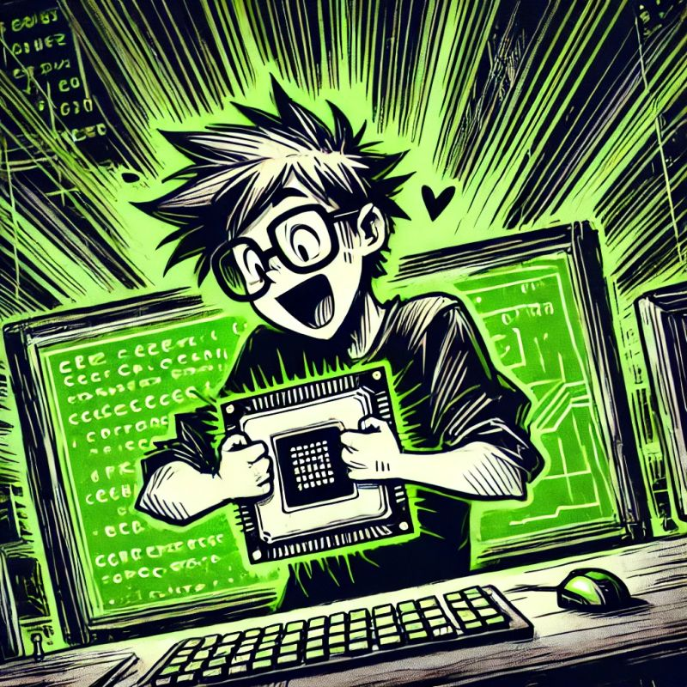
It is time! The dawn of Green Coding is here.

Slide 2

Meetup Sponsored By

Slide 3
Truth about Green Coding We don't have all the solutions yet, but the journey to find them is where we are right now.

Slide 4

What is Green Coding @ its core?

Slide 5

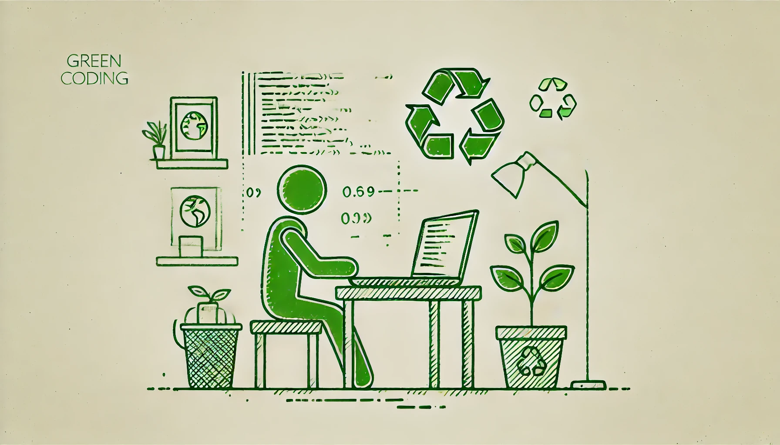
Green Coding Core
ACTIVITY not the product

Slide 6
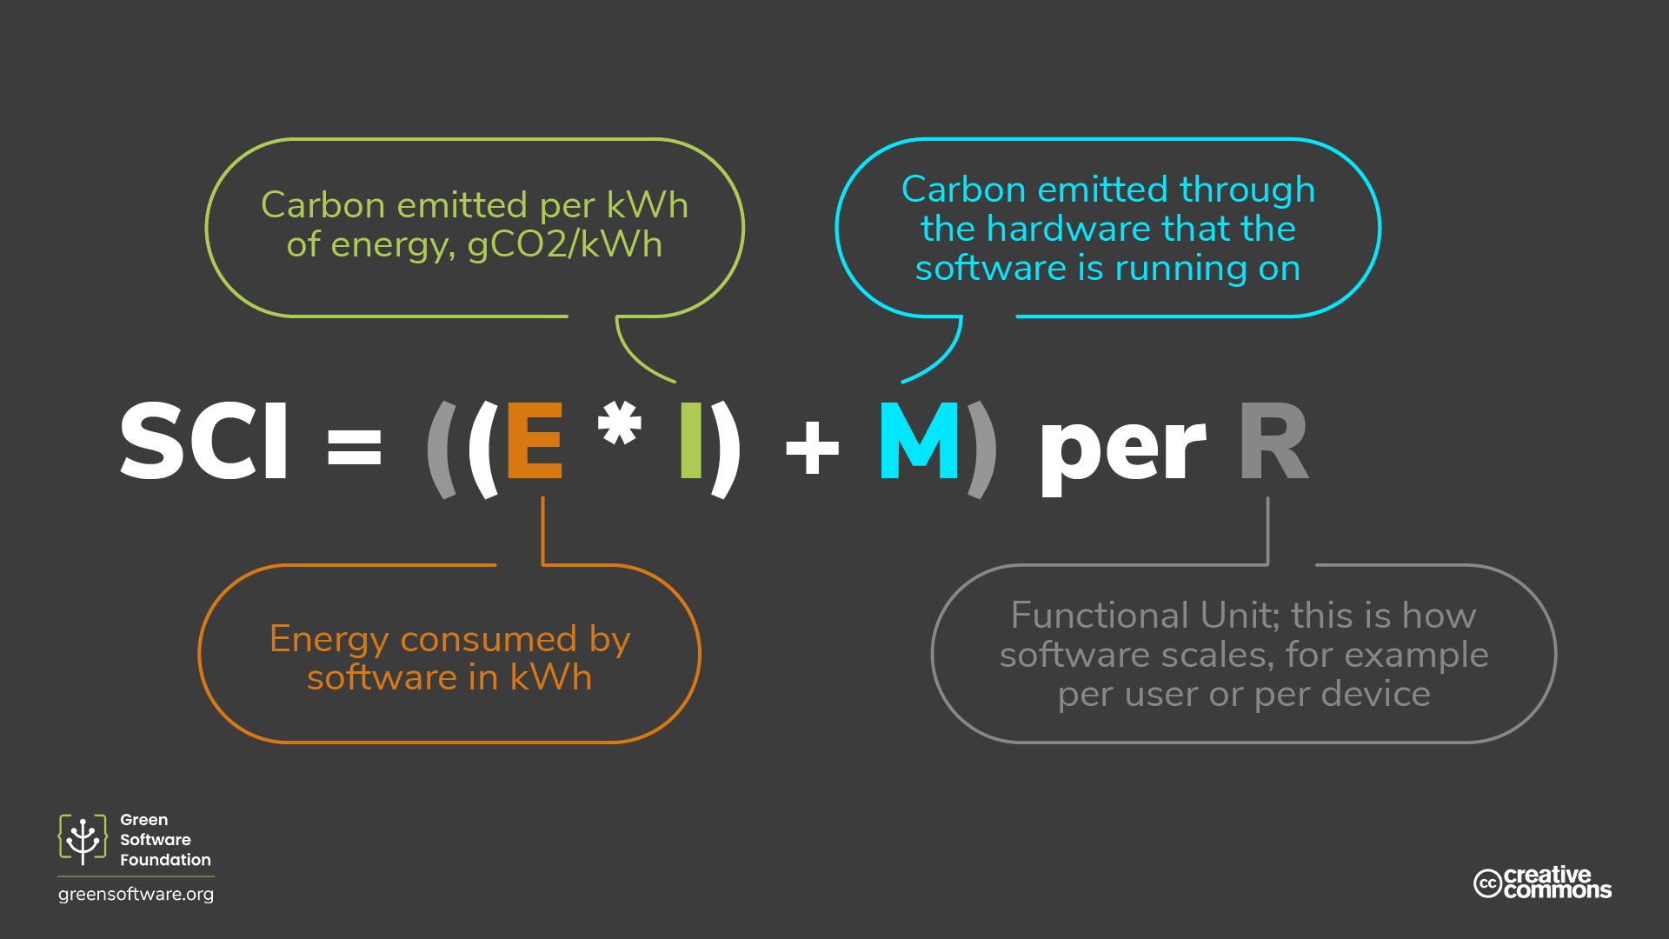
Green Coding Core

Slide 7
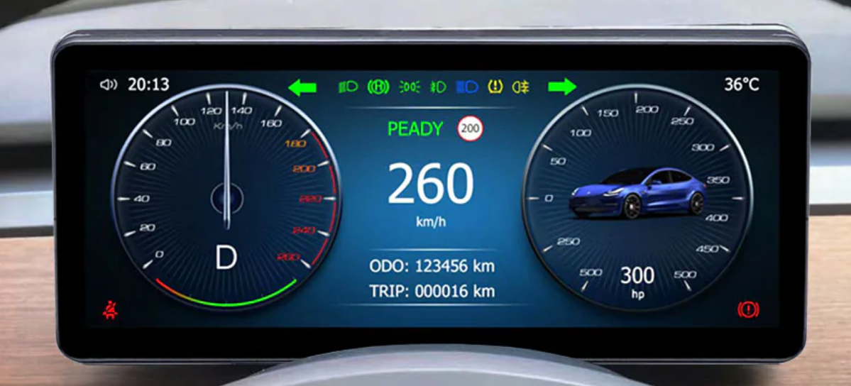
What metrics do you see? Tell us!

Slide 8
What metrics do we need in green coding?

Slide 9
Metrics we will log from our code
Core Metrics
kWh Energy consumed.

Slide 10
Metrics we will log from our code
Core Metrics
Underlying Hardware Resource Type

Slide 11
Metrics we will log from our code
Core Metrics
Activity/Idle time Per Core Original CPU Metrics

Slide 12
Metrics we will log from our code
Core Metrics
Requests / Users doing [X] / Etc. Per Functional Unit (Software Route)

Slide 13
Metrics we will log from our code
Core Metrics
Time & Location of running Code

Slide 14
Let's focus on CPUs for now. Why?

Slide 15
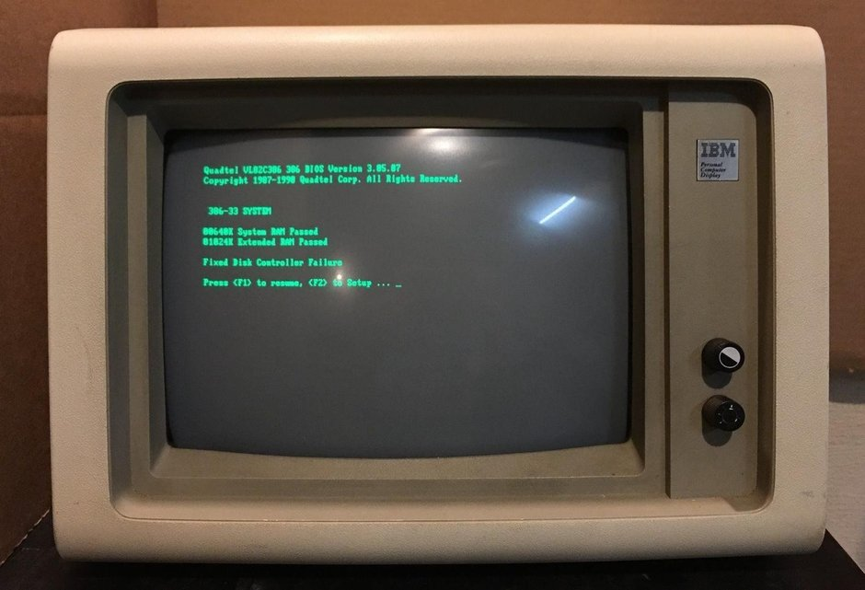
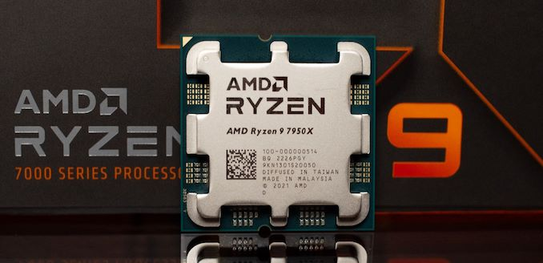
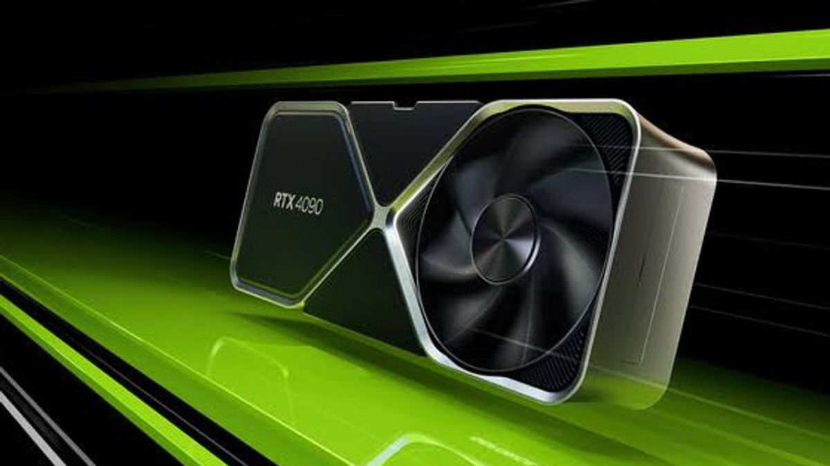
Let's focus on CPUs for now. Why?

Slide 16
Core focus for now - CPUs
What to know?
No code isolation To measure the energy consumption of code, we need to monitor everything happening on a 'machine'.

Slide 17
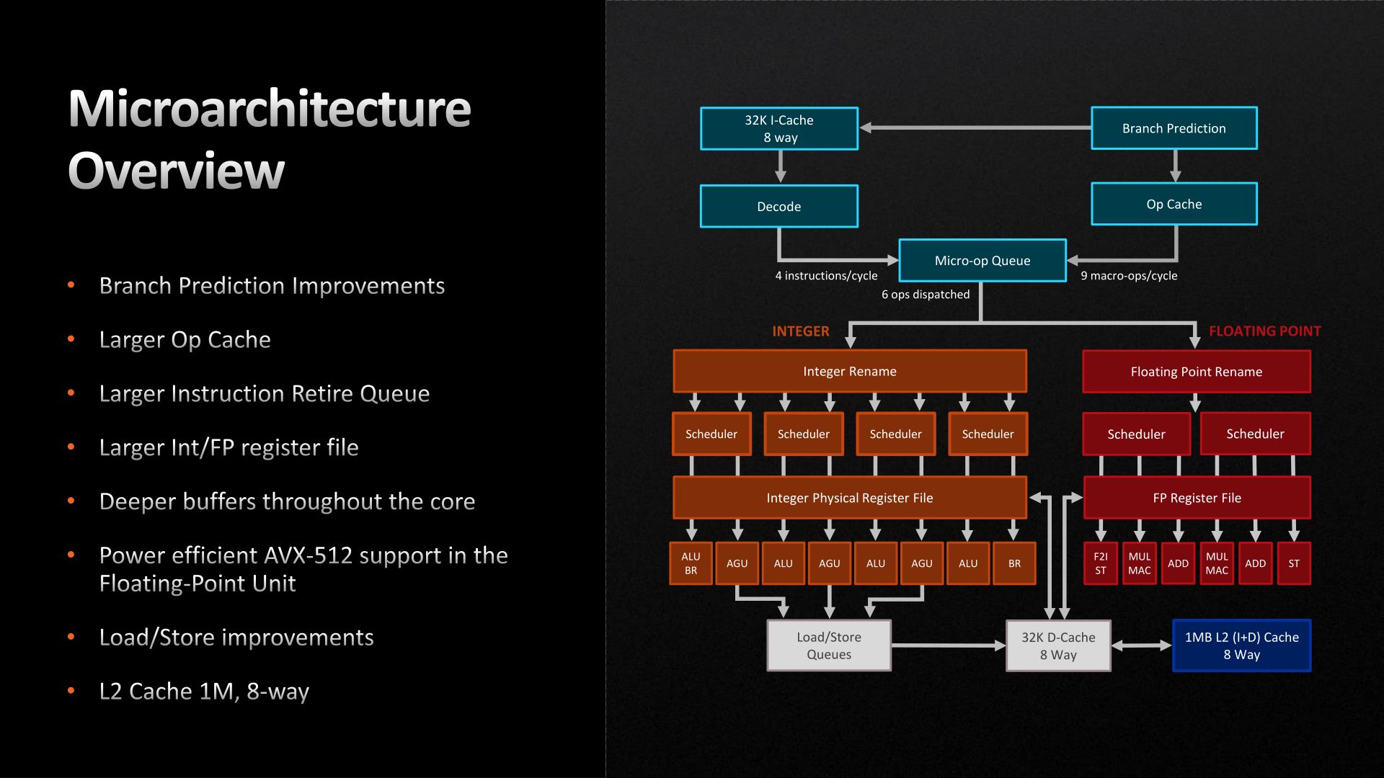
Core focus for now - CPUs

Slide 18

Core focus for now - CPUs
The longer the queue, the more the core (Cashier) is boosted.
By analysing the time spent processing the queue, we can estimate the current level of boost.
This reflects CPU utilization.

Slide 19

Core focus for now - CPUs
The longer the queue, the more the core (Cashier) is boosted.
By analysing the time spent processing the queue, we can estimate the current level of boost.
This reflects CPU utilization.

Slide 20
Core focus for now - CPUs
What to know?
Core Frequency & Voltage Vary based on queued work. Energy consumption increasing as more work is queued.

Slide 21
Core focus for now - CPUs
What to know?
Time measurement in milliseconds Instead of hours (kWh) Although we need it for E in SCI eventually.

Slide 22
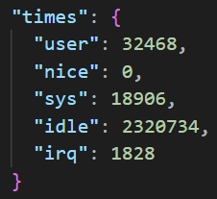
Core focus for now - CPUs
What to know?
Time measurement in milliseconds Instead of hours (kWh)
Tracking starts from boot

Slide 23
Core focus for now - CPUs
Watt measures the rate of energy transfer,
with 1 Watt equaling 1 Joule of energy per second.
A CPU core with a maximum of 6.5 Watt: 6.5 J/s
0.0065 J/ms 6.5 / 3,600,000 kWh (we love fractions)

Slide 24
Core focus for now - CPUs
What to know?
Uncore The CPU components responsible for planning, coordinating, and waiting for work to be assigned to the cores. Baseline power consumption, even during idle periods (like 15-20 J/s)

Slide 25

Core focus for now - CPUs
What to know?
Uncore
15-20 J/s
Part of Code Measurement?

Slide 26

Benchmark environment

Slide 27
Benchmark environment
Interpolation for example of 100 ms
Controlled hardware environment
Root Access
Benchmark
Assume
Estimate

Slide 28

Software Routes
My personal take for now: Code running longer then 100ms

Slide 29
DEMO TIME!
LETSGO!

Slide 30




